Slide 1
Writing a CV (Europass form)
By Ana Delić

Slide 2
If you want to apply for a holiday job or a position in a company, you should send them a CV (curriculum vitae, BE)/résumé (AE)and a covering letter (BE)/cover letter (AE).

Slide 3
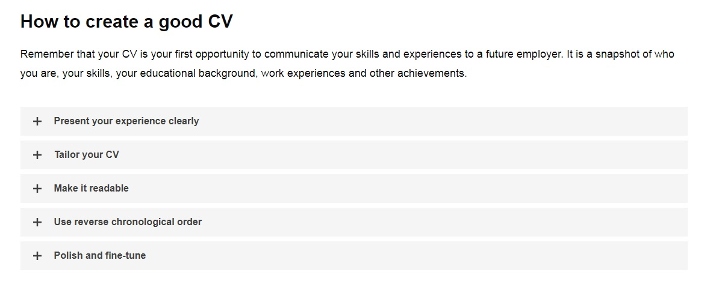

Slide 4
Present your experience clearly
Highlight examples of your skills and experiences matching the job you are applying for. Pay close attention to the details published in the vacancy notice.

Slide 5
Tailor your CV
Make sure you update the ‘About Me’ section to highlight why you are the best person for the job. Do not include a full detailed history. Focus on facts and main points that match the job you have in mind.

Slide 6
Make it readable
Make sure your CV is easy to read. Use clear and simple language. Use strong verbs (e.g. ‘managed’, ‘developed’, ‘increased’).

Slide 7
Use reverse chronological order
Always list the most recent experience on the top followed by previous ones. In case of long gaps in working or learning, include an explanation.

Slide 8
Polish and fine-tune
Check for spelling and grammar mistakes, provide a professional e-mail address, and add a professional photograph of yourself.

Slide 9
A résumé is usually divided up into the following sections:
Personal and contact information: address, telephone number, (professional) email address, photo, age
Education and qualifications: start off with the most recent and only mention the most important ones

Slide 10
Work history and experience: list the most relevant and recent first, including holiday jobs, voluntary work and placements; the employer's name, your job title and how long you worked there, as well as giving a brief description of what you did in each job
Skills: put in skills that are relevant to the job; show that you have the skills by giving examples rather than just listing them
Interests and activities: give brief details and choose ones that also reflect your skills and personality (but be truthful!)

Slide 11
USEFUL VOCABULARY : self-descriptive words
Use those on a resume:
Insightful.
Professional.
Astute.
Diligent.
Reliable.
A Self-starter.
Motivated.
Dynamic.
Organized.
Passionate.
Meticulous.
Thoughtful.
Intelligent.
Cutting Edge.
Ingenious.
Unique.
Skilled.
Competent.
Devoted.
Genuine.
Attentive
Dedicated.
Determined.
Sincere.
Knowledgeable.
Persistent.
Disciplined.
Honest.

Slide 12
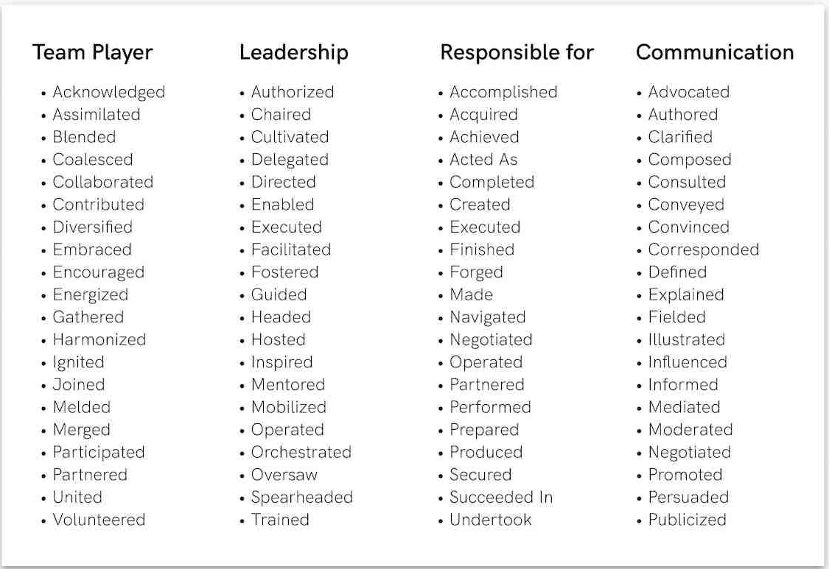
USEFUL VOCABULARY: power words

Slide 13
HOMEWORK – Task 1
FOLLOW PREVIOUSLY EXPLAINED STEPS AND CREATE YOUR OWN CV THAT YOU WOULD SEND TO APPLY FOR THE POSITION ADVERTISED:
Job Brief: The Company “WebMaster INC”, from London is looking for a talented Web Designer to create amazing user experiences. The ideal candidate should have an eye for clean and artful web design. They should also have superior user interface design skills.
The successful candidate will be able to translate high-level requirements into interaction flows and artifacts. They will be able to transform them into beautiful, intuitive, and functional designs.

Slide 14
RESPONSIBILITIES:
Execute all visual design stages from concept to final hand-off to engineering
Conceptualize original website design ideas that bring simplicity and user friendliness to complex roadblocks
Create wireframes, storyboards, user flows, process flows and site maps to communicate interaction and design ideas
Present and defend designs and key deliverables to peers and executive level stakeholders
Establish and promote design guidelines, best practices and standards

Slide 15
Task 2:
Visit the site https://www.thebalancecareers.com/top-interview-questions-and-best-answers-2061225 to prepare for the next step in the job application procedure: The Interview.

Slide 16
Sources:
Green Line Oberstufe. Stuttgart: Klett, 2015, S. 167.
https://europa.eu/europass/en/create-europass-cv
Tom Gerencer, CPRW. 240 Resume Words: Action Verbs, Power Words, Good Adjectives (https://zety.com/blog/resume-action-words#keywords)

