Slide 1
LIFE IN THE BAY OF BOKA
Maša Marković VII-3

Slide 2
Boka Kotorska

Slide 3
BAY OF BOKA(smaller parts)
It is one of most beautiful bays in the world!Boka is located in Montenegro.It has few smaller parts-Herceg-Novi bay,Risan bay,Kotor bay and Tivat bay.Kotor is famous for the mountains and fortresses that were built during the time of Bryzantine Empire,It is the old coastal and cultural centre..Risan bay is famous remnant of the classical culture.I live in Herceg-Novi bay,it`s a town of flowers,and it has a lot of houses with windows faced toward the sun and the sea.Tivat is oriented towards the developoment of tourism as a prior activity.In Boka we can visit City museum and the Archives,the Modern Arts gallery and Old town with Tower clock.

Slide 4
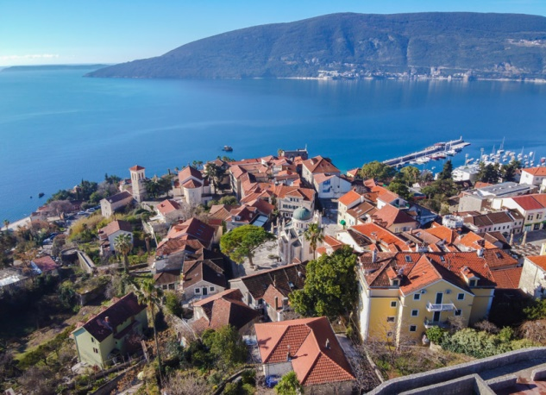
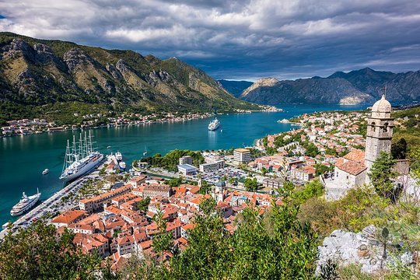
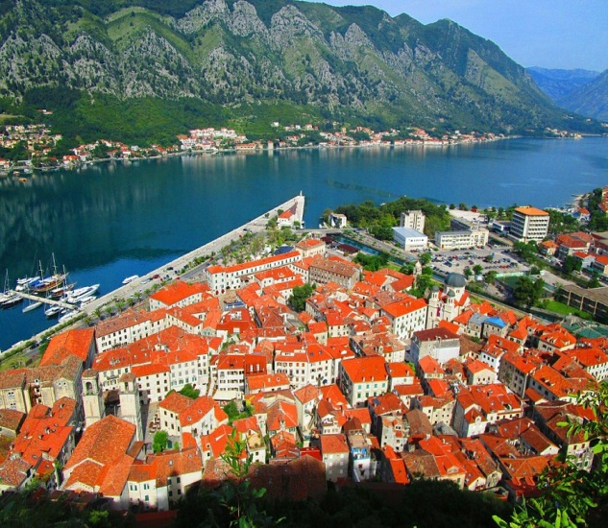
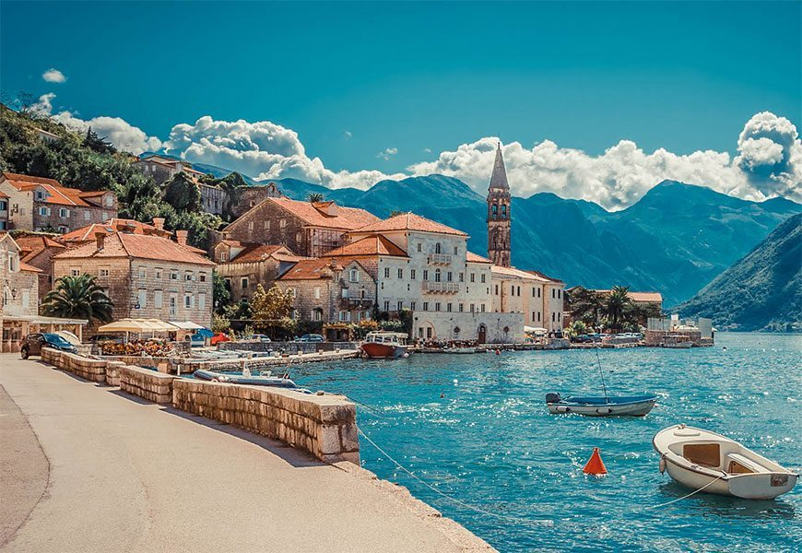
Photos of smaller parts

Slide 5
Life in Boka through years
Life now is very different than long time ago.
NOW: Towns are bigger,people live in big houses,people eat a lot of different tipes of food,we have a lot of types of jobs,we have a lot of types of transport...
LONG TIME AGO:Towns were smaller,people lived in small stone houses,they usually ate fish and vegetables,they many worked in factories and harbours,people used the train called ,,Ćiro“ and cars that were very expensive for transport ...

Slide 6
HOUSES IN BOKA
NOW:houses are very big,they have multiple floors,they have insulatuion,they are made of bricks and blocks,they have a lot of big windows,they have terraces and gardens...
LONG TIME AGO:houses were very small,they sometimes had
multiple floors,they didn`t have insulation, they were made of stone,they had small windows made of glass and colored wood,they didn`t have terraces,they had big gardens...

Slide 7
HOUSES IN BOKA

Slide 8
JOBS IN BOKA
NOW:people do different types of jobs,now,people usually work like:sailors,travel guides,fishermen,hoteliers, hunters,shop assistants,doctors...
LONG TIME AGO:women were usually at home(they took care of children and prepared the food for the family),men worked usually at harbours and factories and they went to fishing,hunting...

Slide 9
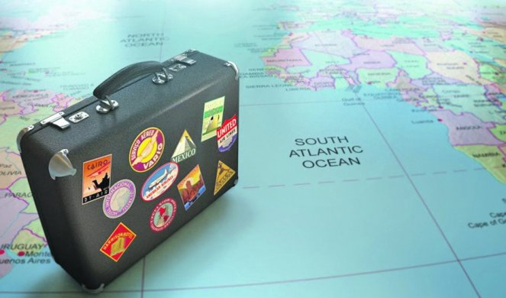
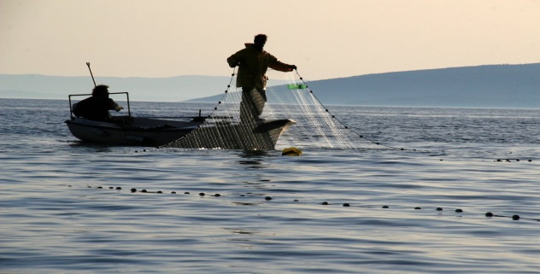
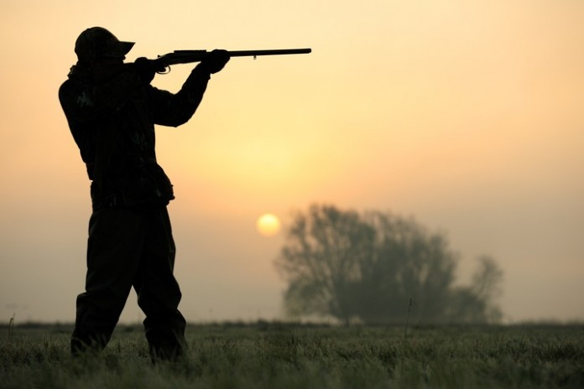
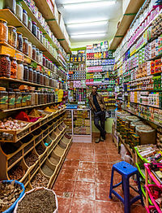
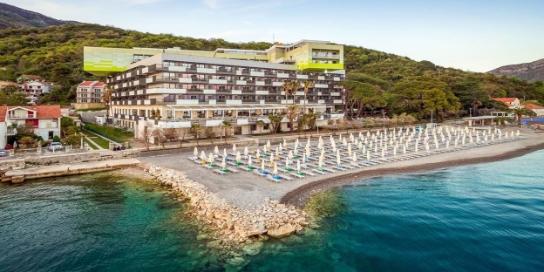
JOBS IN BOKA

Slide 10
FOOD IN BOKA
NOW:people usually eat:pizza,spaghetti,fish specialties,lasagna,peas, barbecue,vegetables,friuts, gnocchi,macaroni,salad,cake,
Shells,squids...
LONG TIME AGO:people usually ate: fish,vegetables,gnocchi,macaroni,eggplants,
Salads,squids,shells...

Slide 11
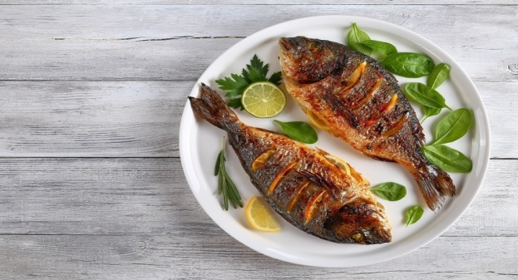
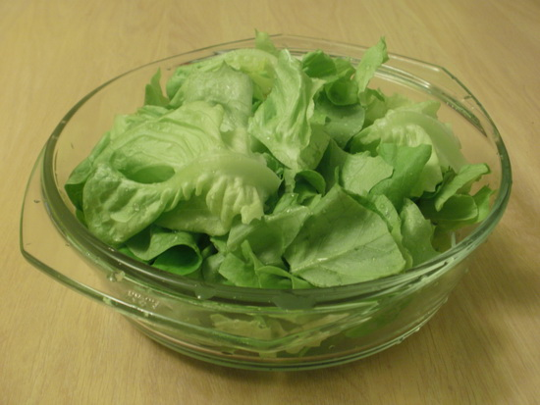
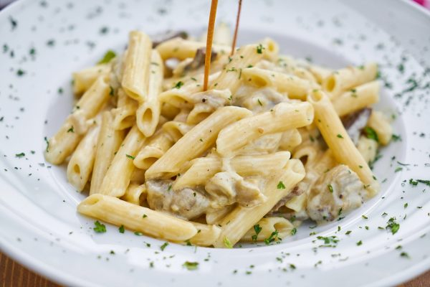
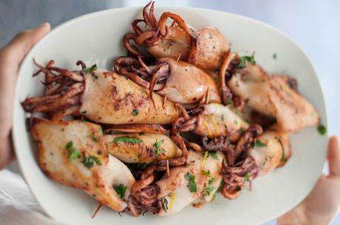
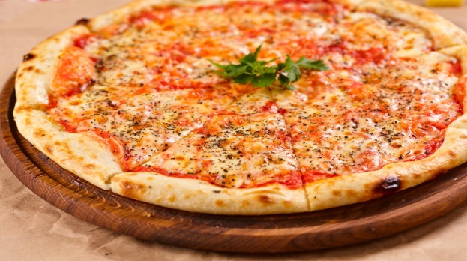
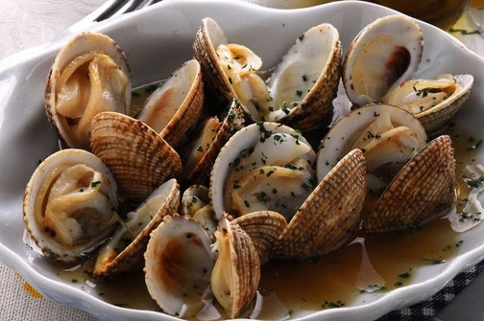
FOOD IN BOKA

Slide 12
TRANSPORT IN BOKA
NOW:boats,cars,buses,
planes,trucks,ferry...
LONG TIME AGO:boats,carriages, train ,bicycle,cars (they were very expensive)...

Slide 13
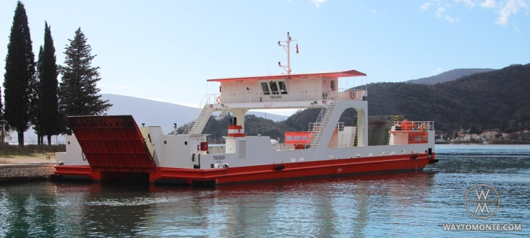
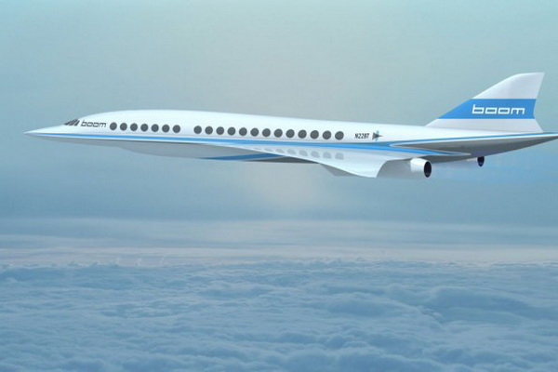
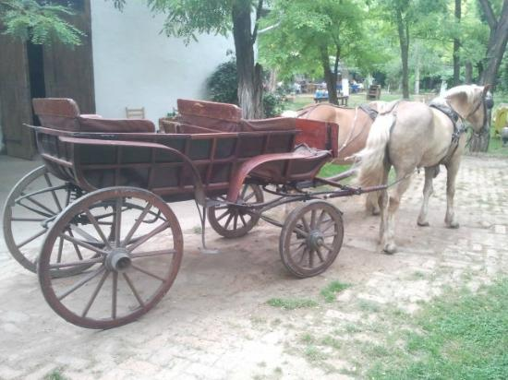
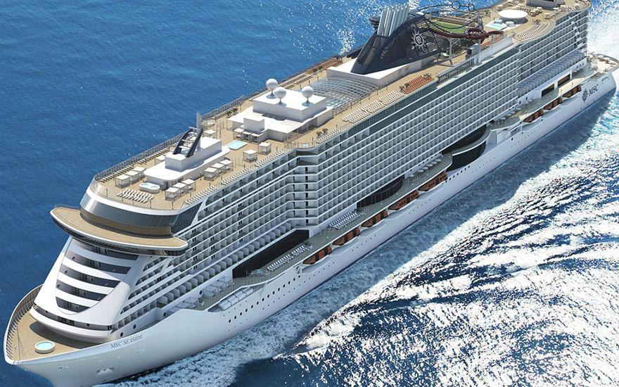
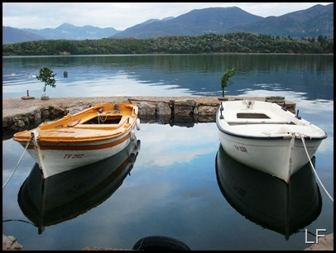
TRANSPORT IN BOKA

Slide 14
FREE TIME IN BOKA
Free time is the same now and long time ago:fishing,riding a bike,playing different types of sports,swimming(in summer),reading books,walking,drawing...

Slide 15
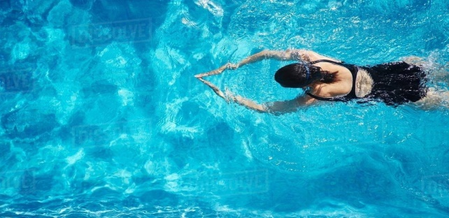
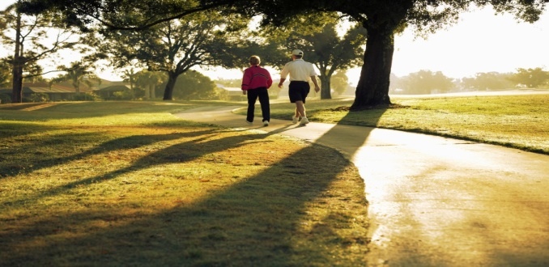
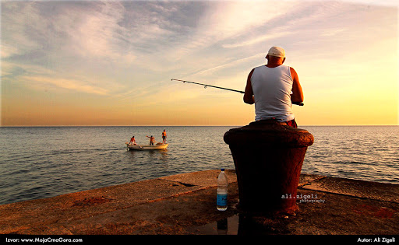
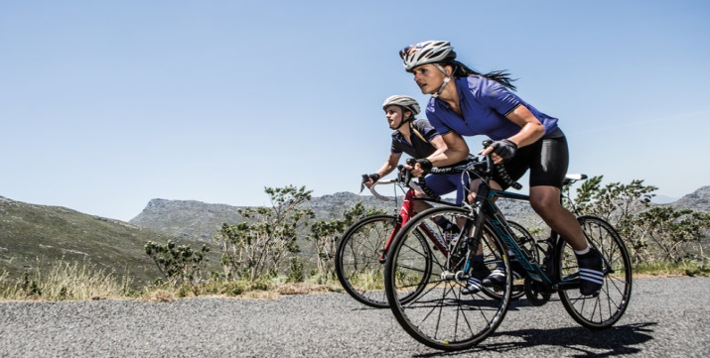
FREE TIME IN BOKA

Slide 16
THATS IT!THANKS FOR YOUR ATTENTION!!!

