Slide 1
MARINE POLLUTION

Slide 2
PLASTICS
SEWAGE
MARINE POLLUTION
INDUSTRIAL WASTE
OIL SPILLS
PESTICIDES/FERTILISERS FROM FARMS

Slide 3
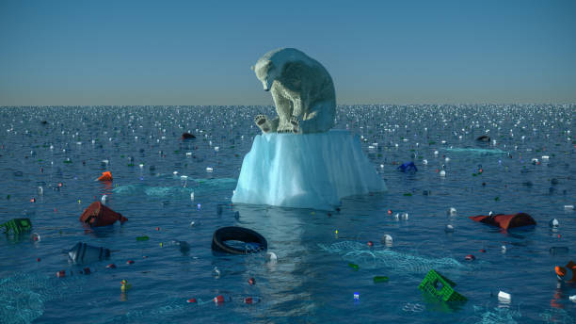
PLASTICS
Water bottles
Food wrappers
Packaging
Plastic bags
Plastic toys
Fishing gear
...

Slide 4
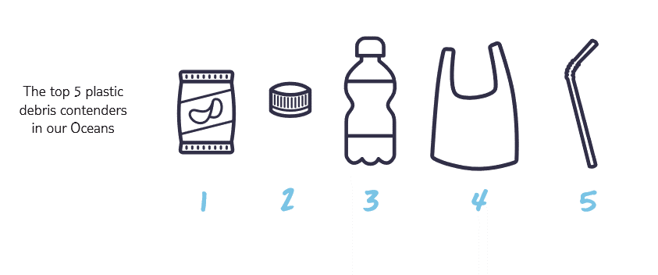

Slide 5
Before you watch the video, let’s check some vocabulary.
Match the words with the definitions.
pollution (n) - rubbish / garbage
litter (n) - things that are left after you use something
dump (v) - to make something dirty, polluted or poisoned
affect (v) - harmful waste which has been put into the environment
waste (n) - to have an effect on something; to cause damage to something
contaminate (v) - to get rid of something
source (n) - deserving to be blamed for something that has happened
responsible (adj) - the cause of a problem or the place where it began

Slide 6


Slide 7
Watch the video and complete the missing information.
Marine pollution, 1st theme of the 2017 #OurOcean conference – YouTube
______________ tonnes of litter are dumped in the sea every year.
By 2050 there will be more ___________ in the ocean than fish.
Plastics are killing __________________ seabirds and __________________ marine mammals a year.
_______________ of marine litter comes from land sources.
Contaminated sea food affects the health of _______________.
10 million
plastic
1 million
100,000
80%
people

Slide 8
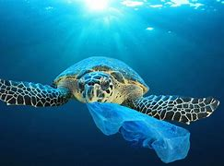
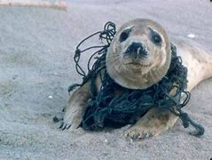
How does plastic in the sea affect marine life (fish, seabirds, marine mammals, sea turtles, small organisms)? Discuss in groups and write notes.

Slide 9
Do you use a lot of plastic? How can you, as individuals, minimise waste or prevent plastic from reaching the sea?
Discuss in your group and give at least three examples.
Use re-usable water bottles instead of single-use ones
Use re-usable bags instead of plastic ones
Don’t use straws or single-use plastic utensils
Pick up rubbish - clean the beaches
Recycle

Slide 10
Facts about plastic pollution in the oceans
90%
1. _____________ of all rubbish floating on the surface is made of plastic.
a) 50 % b) 70% c) 90%
2. About 10 million tonnes of plastic enter the ocean every year – that’s like 1 garbage truck of plastic dumped into the ocean every ____________ .
a) minute b) hour c) day
3. Plastic items take ___________________ to decompose.
a) 10 years b) 50 years c) hundreds of years (up to a thousand)
4. More than ______________ of sea turtles have consumed plastic.
a)20% b) 30% c) 50%
5. _____________ of seabirds eat plastic rubbish mistaking it for food.
a)20% b) 50 % c) 90%
minute
hundreds of years
50%
90%

Slide 11
Useful links:
https://youtu.be/yNNPc-8R5Ts
A Plastic Ocean | LearnEnglish Teens - British Council
Plastic ocean campaigner | LearnEnglish Kids | British Council

Slide 12
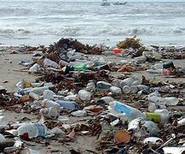
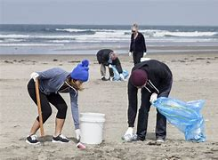
BE PART OF THE SOLUTION, NOT THE POLLUTION!

Slide 13
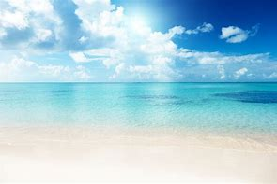
THANK YOU!

